Slide 1
Selecting Fryers for Market Projects

Slide 2
What’s the Project?
Meat Pen
Single Fryer
Age: under 10 weeks
Weight: 3.5-5.5 lbs.
Judging Criteria:
meat type: 40 points
flesh condition: 30 points
uniformity: 20 points
fur: 10 points
Age: under 10 weeks
Weight: 3.3-5.5 each lbs.
Judging Criteria
meat type: 45
flesh condition: 35
fur: 20

Slide 3
The Basics
Get the best foundation stock you can
invest in a buck
Complement faults
Quality feed makes a difference
17-18%
Good sanitation and ventilation are super important
Give them space

Slide 4
Raising Fryers
Breed more than one doe
Keep litters to 6 if possible
Constant fresh feed and water
Separate from doe at 5-6 weeks
Track weight
Feed grass hay to hold weight

Slide 5
Posing

Slide 6
Top View

Slide 7
Topline

Slide 8
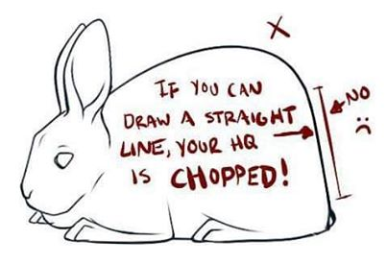
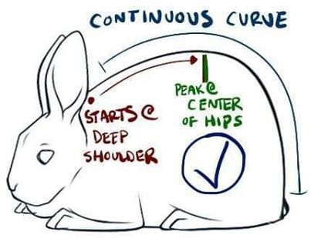
More Topline examples

Slide 9
Hindquarters

Slide 11
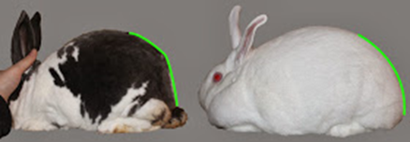
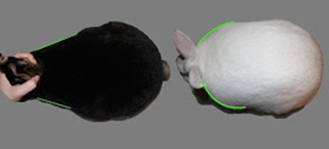

Slide 12
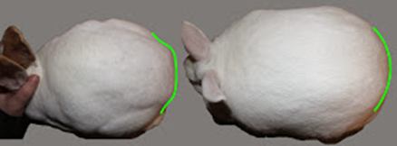
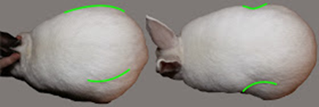

Slide 13
