Slide 1
Selecting and Caring For Rabbits

Slide 2
The Basics
Even if you only want one rabbit to also be a pet, get a quality rabbit
just as much to feed
likely better health and temperament
Pick a breed you like
SOP and arba.net
Smaller isn’t necessarily better

Slide 3
Supplies
Wire cage with pan is best
.75 square feet per pound
1 square foot per pound for breeding
Place out of drafts, ventilation
If outside, ventilation and protection from elements
still wire floor

Slide 4
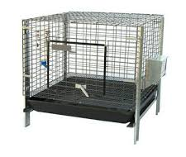
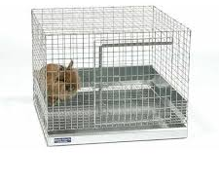
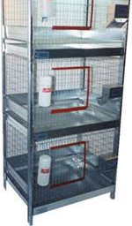
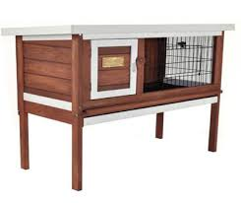
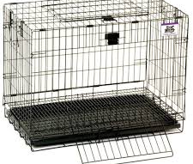

Slide 5
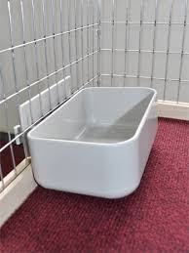
Supplies
feed bowl
attaches to side or heavy
water bottle or bowl
toys
paper towel rolls, whiffle balls, wood blocks, safe sticks, cat toys with bells

Slide 6
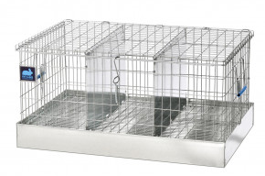
Supplies
carrier
do not use cat carrier
bedding for cage and carrier pans
pine shavings, pine pellets, puppy pads
nail clippers
brush

Slide 7
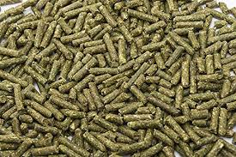
Feed
Fresh is important (not over two months old)
15-18% protein
no corn in ingredients
only pellets
no junk
grass hay good, but not necessary
careful with treats (over six months)
dandelion leaves, raw sweet potato, sliver of banana

Slide 8
General Care
Clean cage once a week MINIMUM
Ammonia will kill rabbits
Trim nails monthly or as needed
Brush when needed
Feed at the same time daily
1 oz per pound of rabbit to start
Constant FRESH water

Slide 9
Selecting
Find a reputable breeder
General health check
bright, clear eye
dry nose, no matting
clean bottom and vent area
clean fur (no stains), no bald patches

Slide 10
Posing

Slide 11
Posing

Slide 12
Top View

Slide 13
Topline

Slide 14
Hindquarters

Slide 16
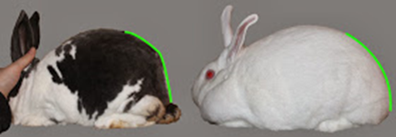
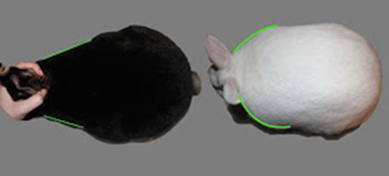

Slide 17
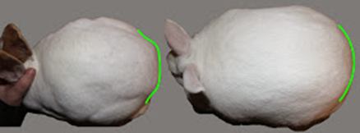
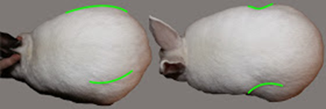

Slide 18
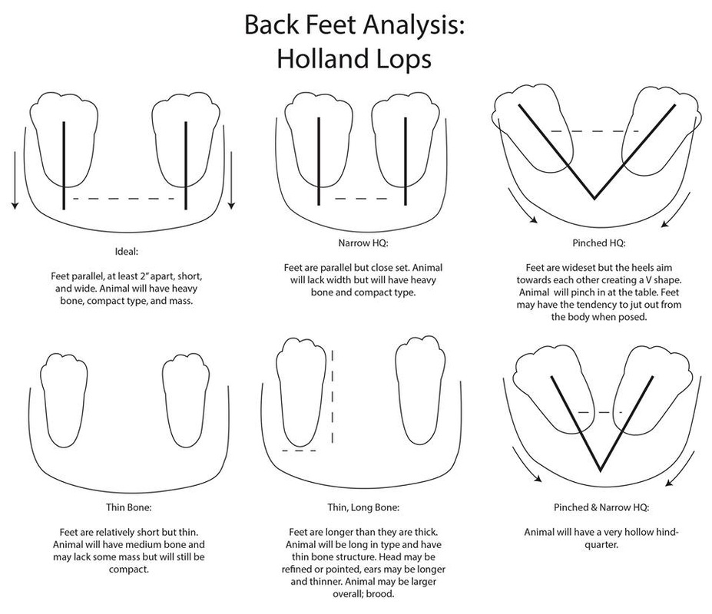

Slide 19
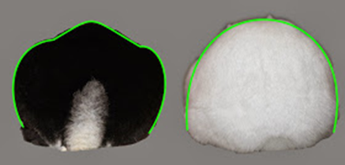
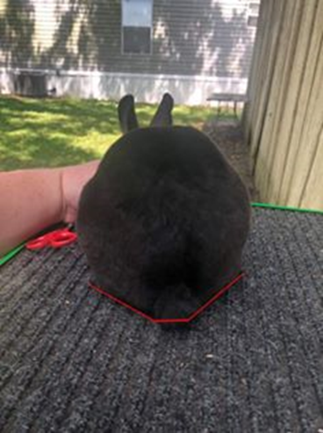
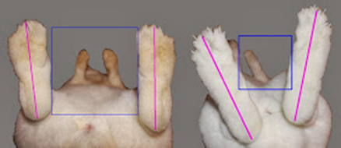

Slide 20
